Slide 1
Search for Top Squarks via All-hadronic Decay Channels with Heavy Object Tagging
Matthew Kilpatrick
Doctoral Candidate
Rice University

Slide 2
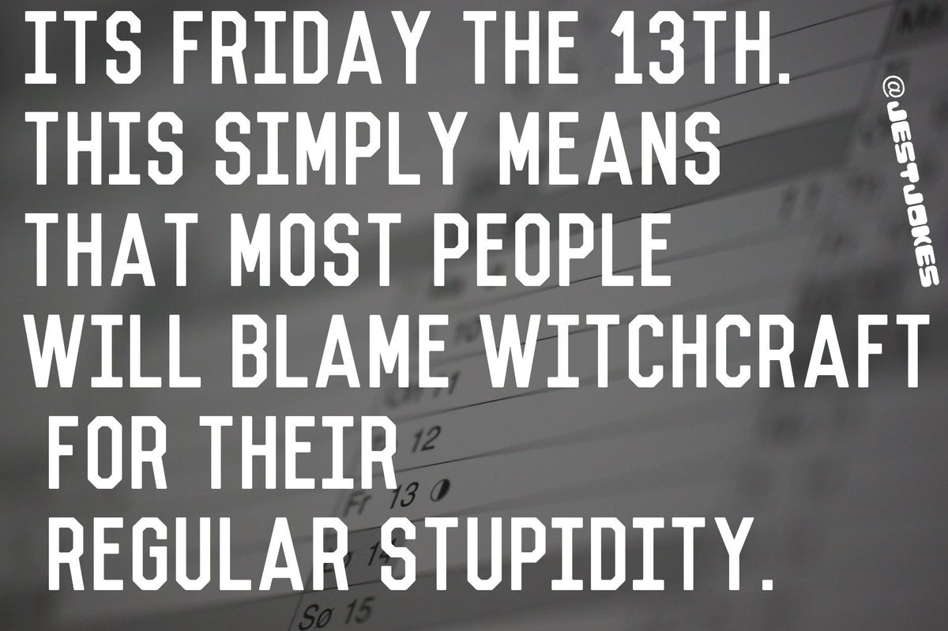
I
MY

Slide 3
Outline
Standard Model
What is it?
Dark Matter
Why SUSY?
Compact Muon Solenoid
Different methods of detection
All-hadronic Top Squark Search
Kinematic Variables
Search region design
Background estimation

Slide 4
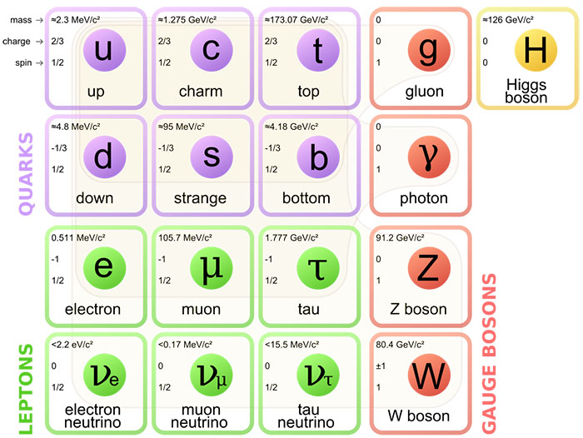
Standard Model
What can the Standard Model do?
All current predictions have been confirmed
4 fundamental forces
3 generations of quarks/leptons
Standard Model can’t explain:
Hierarchy Problem
Dark matter
Grand Unified Theory

Slide 5

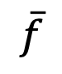
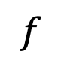
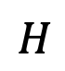
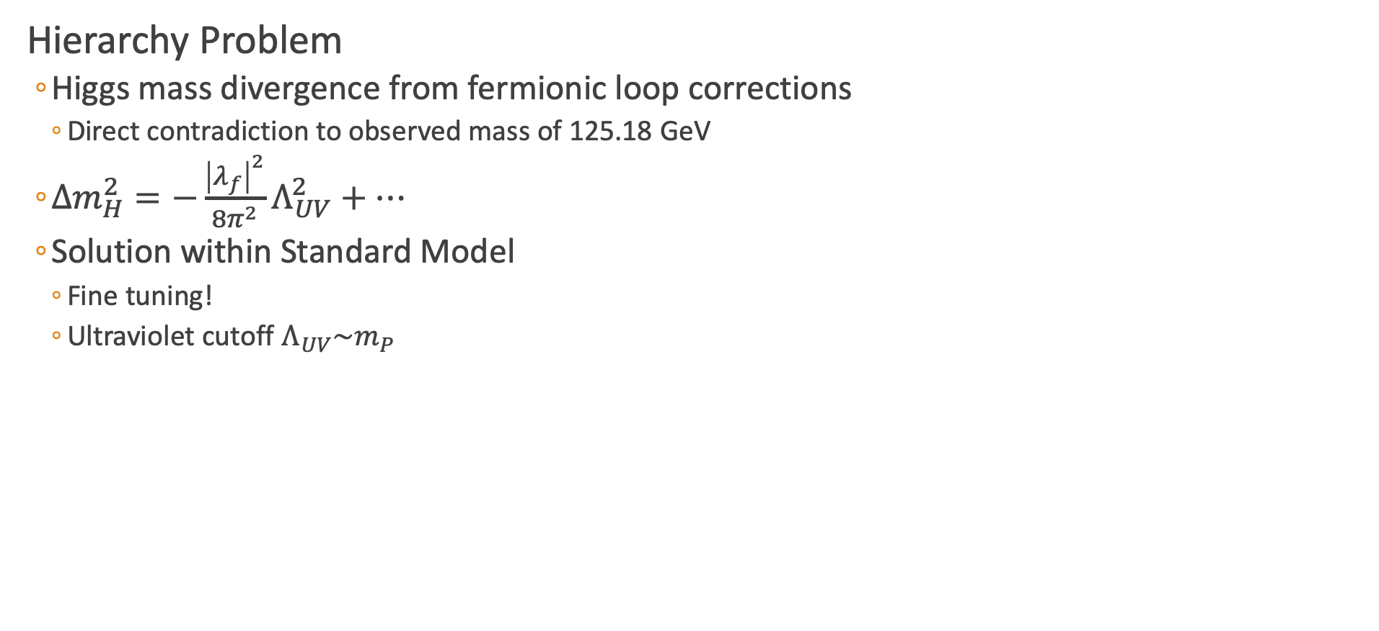
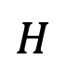
Hierarchy Problem
Hierarchy Problem
Higgs mass divergence from fermionic loop corrections
Direct contradiction to observed mass of 125.18 GeV
$Δm_{H}^{2}=−\frac{{\left|λ_{f}\right|}^{2}}{8π^{2}}Λ_{UV}^{2}+⋯$
Solution within Standard Model
Fine tuning!
Ultraviolet cutoff $Λ_{UV}\sim m_{P}$
$$f$$
$$H$$
$$H$$
$$\overline{f}$$

Slide 6
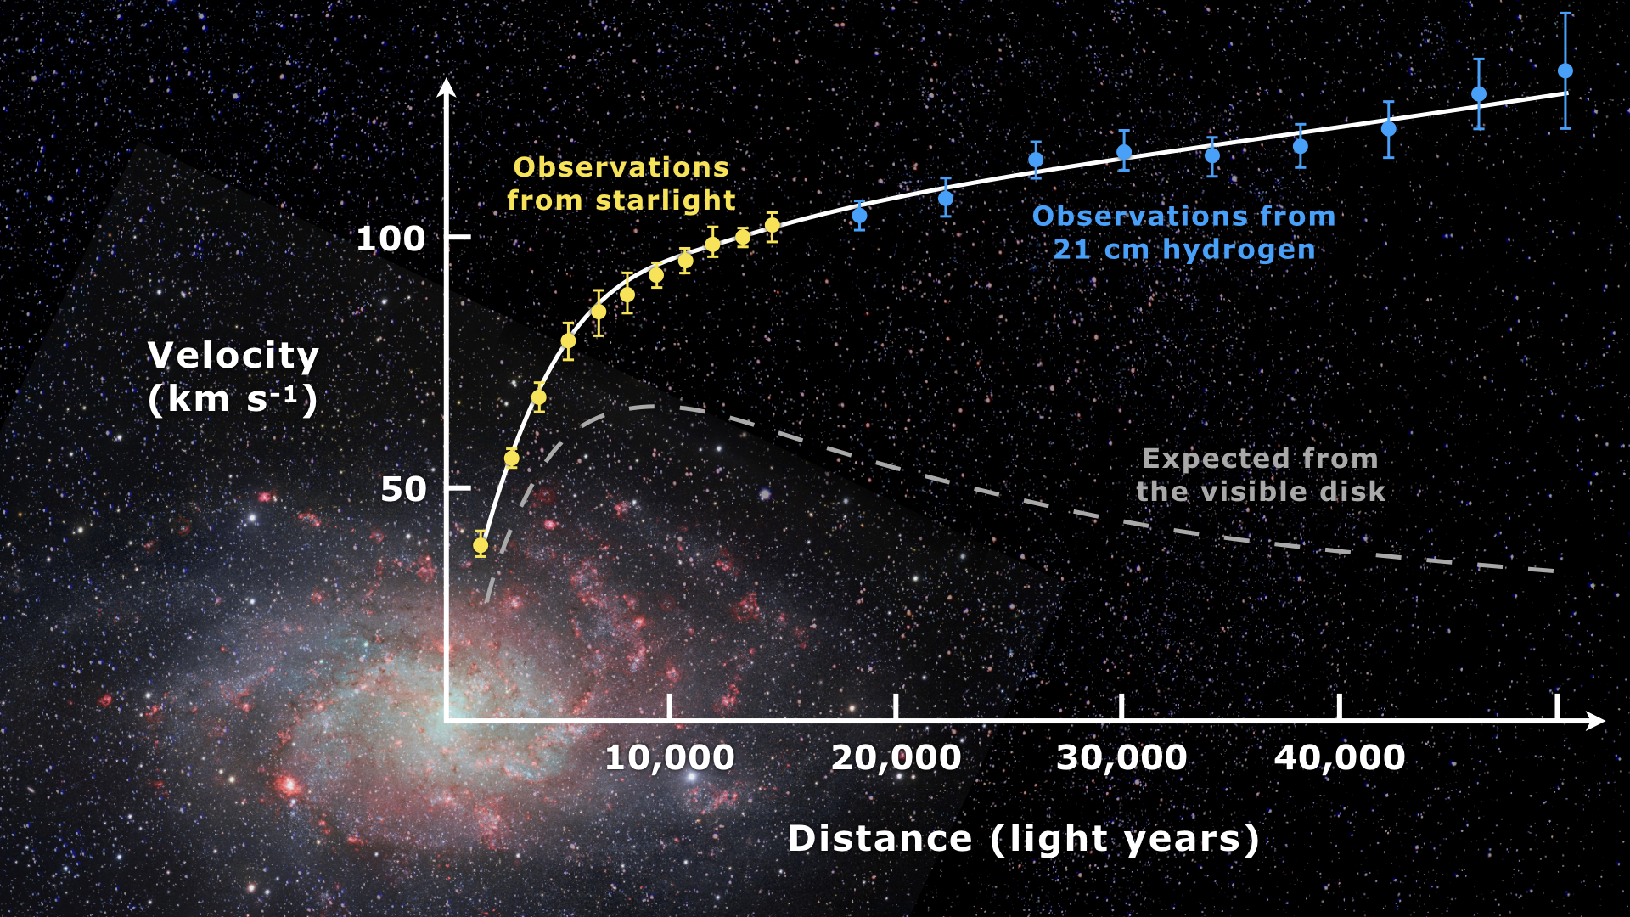
Dark Matter
Galactic Velocit Curves (Messier 33)
Radial velocity of galaxies is large
Not explainable with visible matter and current gravitational theories
Either:
Alternative theory of gravity
“Dark matter” interacting gravitationally
Gravitational Lensing
Mass curves spacetime
Deforms galaxies that move through
Use a gravitational lens methods to find total amount of matter
Disagrees with amount of visible matter
[1]
Notes:
Explain with a modified Newtonian gravity at low accelerations or Dark Matter

Slide 7
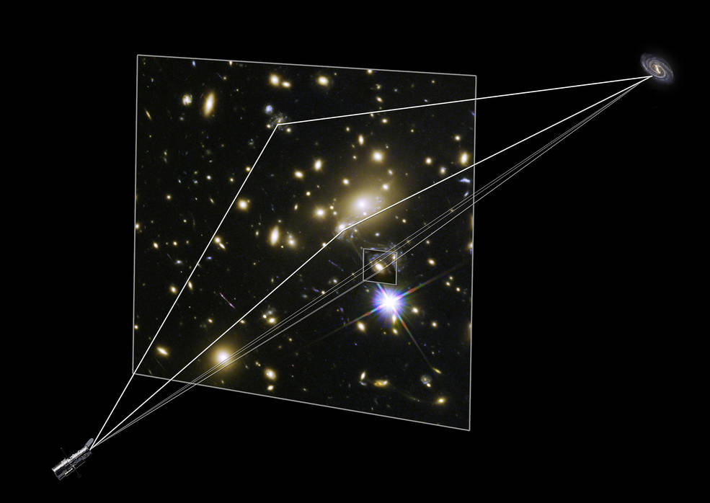
Dark Matter
Galactic Velocit Curves (Messier 33)
Radial velocity of galaxies is large
Not explainable with visible matter and current gravitational theories
Either:
Alternative theory of gravity
“Dark matter” interacting gravitationally
Gravitational Lensing
Mass curves spacetime
Deforms galaxies that move through
Use a gravitational lens methods to find total amount of matter
Disagrees with amount of visible matter
[1] [2]

Slide 8
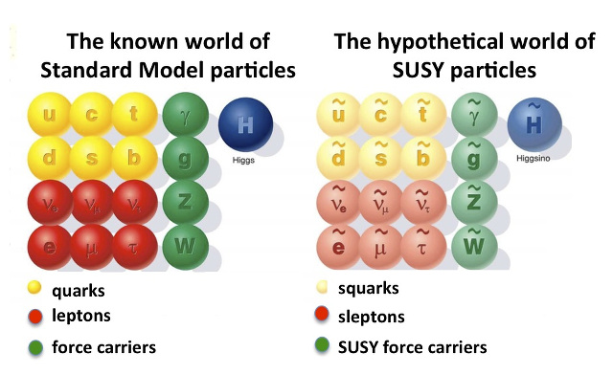
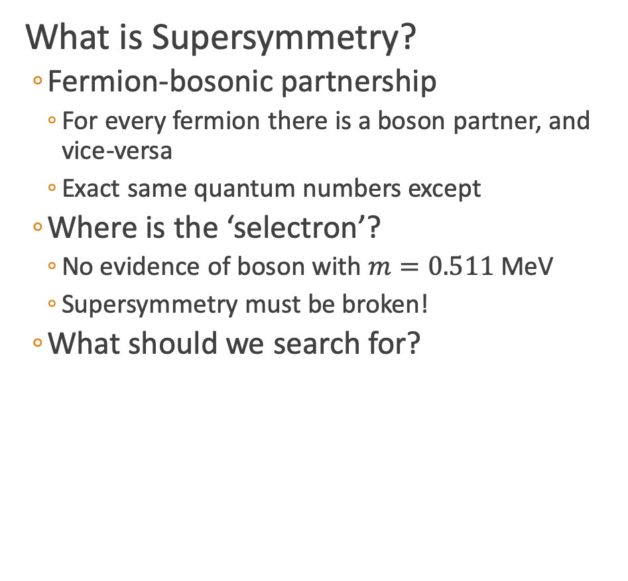
What does Supersymmetry potentially solve?
What is Supersymmetry?
Fermion-bosonic partnership
For every fermion there is a boson partner, and vice-versa
Exact same quantum numbers except
Where is the ‘selectron’?
No evidence of boson with $m=0.511$ MeV
Supersymmetry must be broken!
What should we search for?

Slide 9
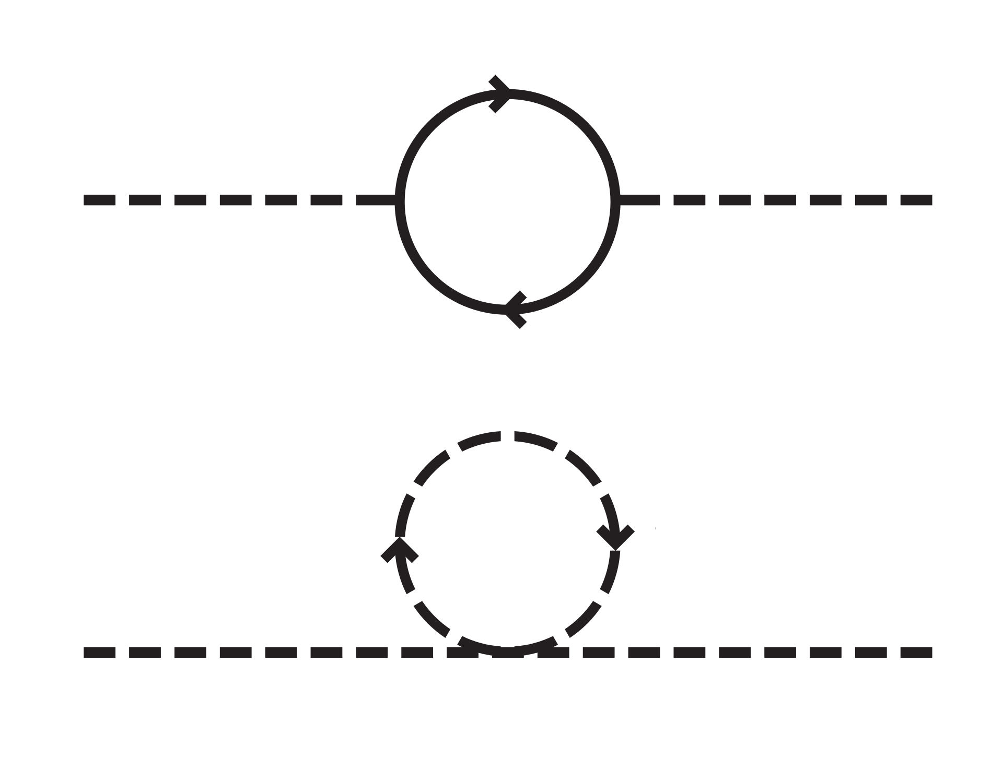
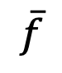
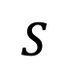
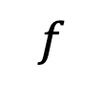
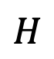
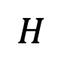
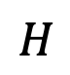
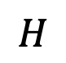
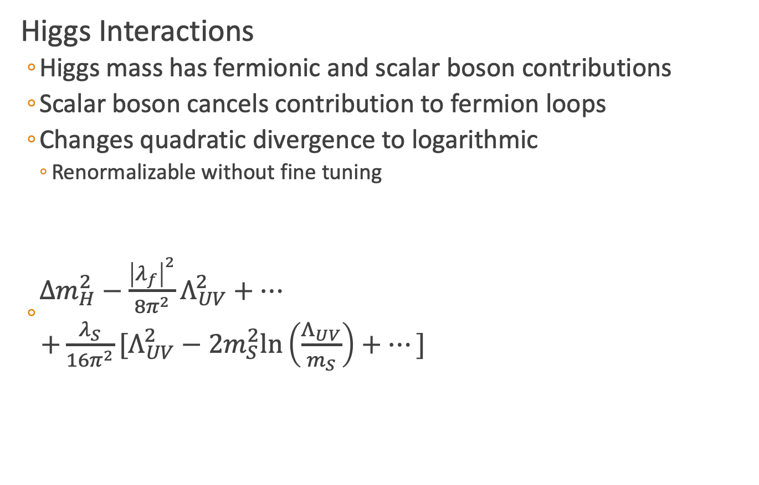
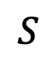
Hierarchy Solution
Higgs Interactions
Higgs mass has fermionic and scalar boson contributions
Scalar boson cancels contribution to fermion loops
Changes quadratic divergence to logarithmic
Renormalizable without fine tuning
$\begin{matrix}Δm_{H}^{2}−\frac{{\left|λ_{f}\right|}^{2}}{8π^{2}}Λ_{UV}^{2}+⋯ \\ +\frac{λ_{S}}{16π^{2}}[Λ_{UV}^{2}−2m_{S}^{2}\text{ln}\left(\frac{Λ_{UV}}{m_{S}}\right)+⋯] \end{matrix}$
$$f$$
$$H$$
$$H$$
$$\overline{f}$$
$$S$$
$$S$$
$$H$$
$$H$$
Notes:
P_R = (-1)^3(B-L)+2s

Slide 10
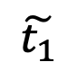
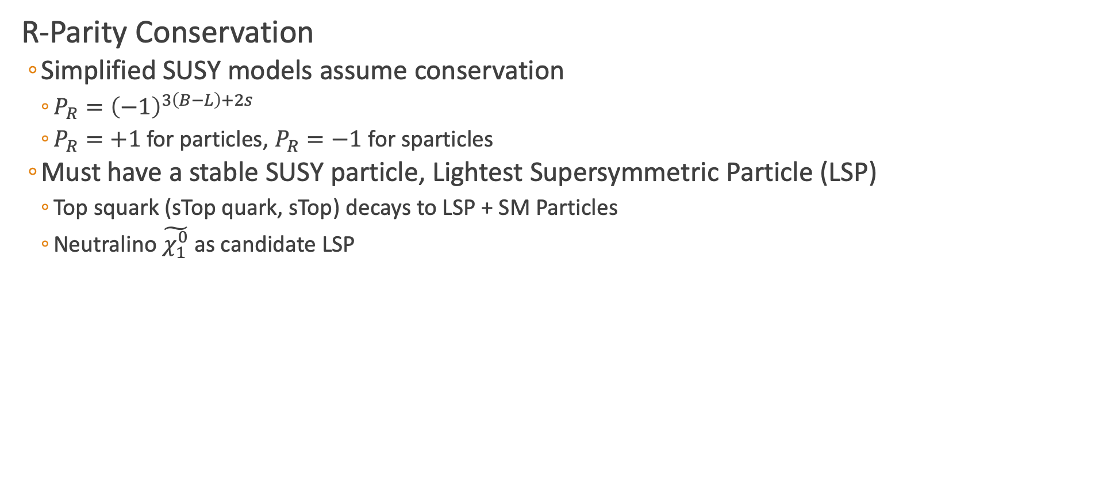
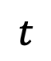
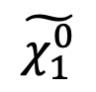
Dark Matter Candidate
R-Parity Conservation
Simplified SUSY models assume conservation
$P_{R}={\left(−1\right)}^{3\left(B−L\right)+2s}$
$P_{R}=+1$ for particles, $P_{R}=−1$ for sparticles
Must have a stable SUSY particle, Lightest Supersymmetric Particle (LSP)
Top squark (sTop quark, sTop) decays to LSP + SM Particles
Neutralino $\tilde{χ_{1}^{0}}$ as candidate LSP
$$t$$
$$\tilde{t_{1}}$$
$$\tilde{χ_{1}^{0}}$$

Slide 11
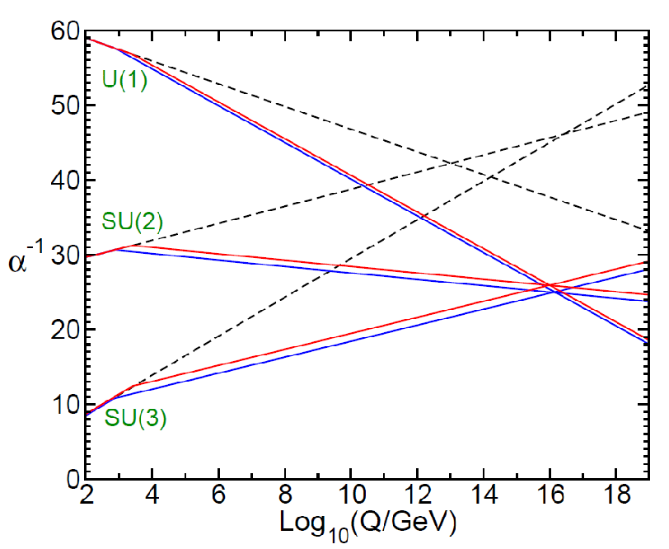
Grand Unified Theory
Unification of the Gauge Couplings
SUSY allows for EM, Weak, and QCD to unify at large energy scales
Notes:
Two loop renormalization group evolution of the inverse gauge couplings $α_{a}^{−1}(Q)$ in the SM (dashed) and MSSM (solid). In the MSSM, the sparticle masses are treated as a common threshold varied between 750 GeV and 2.5 TeV.

Slide 12
Outline
Standard Model
What is it?
Dark Matter
Why SUSY?
Compact Muon Solenoid
Different methods of detection
All-hadronic Top Squark Search
Kinematic Variables
Search region design
Background estimation

Slide 13
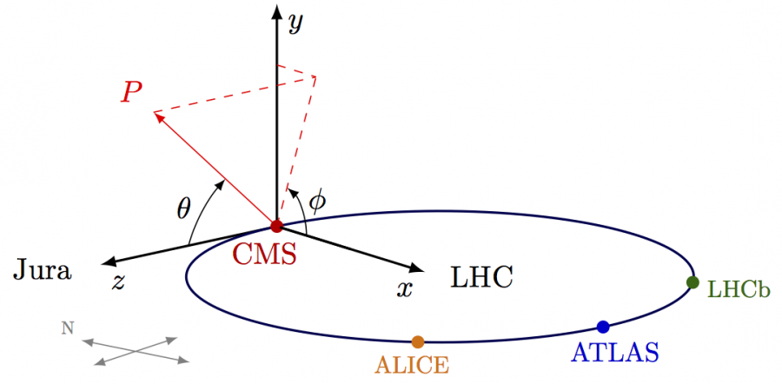
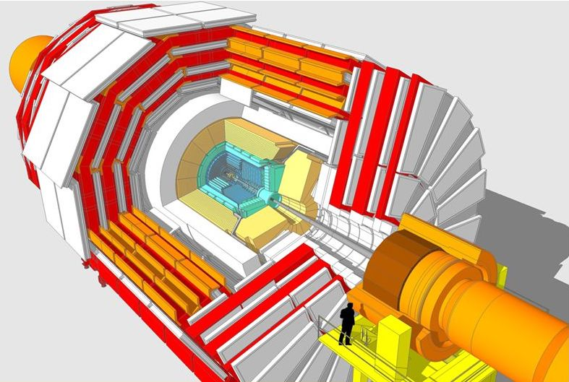
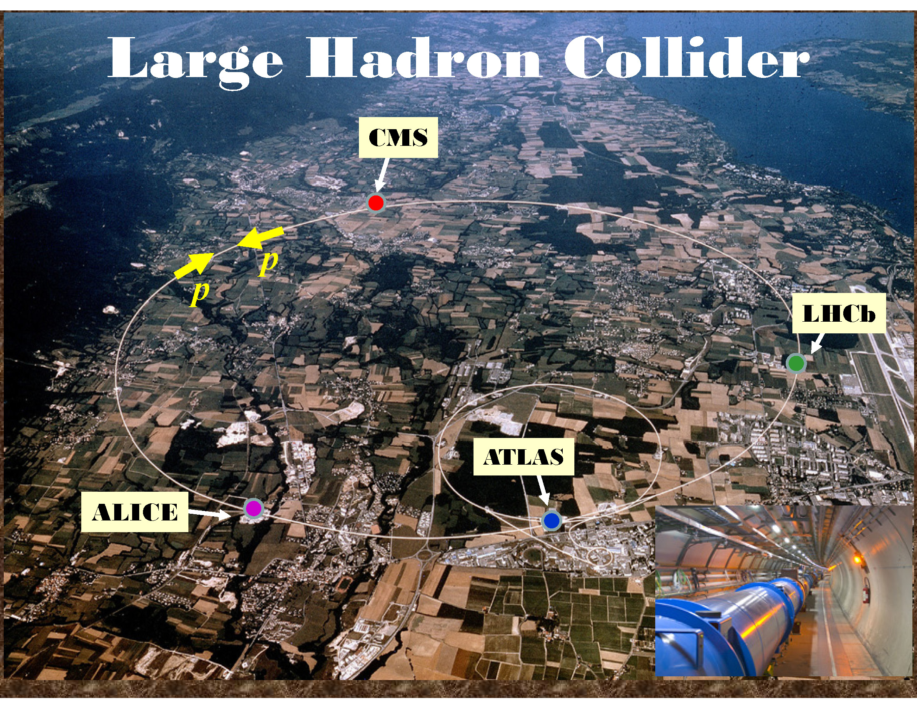
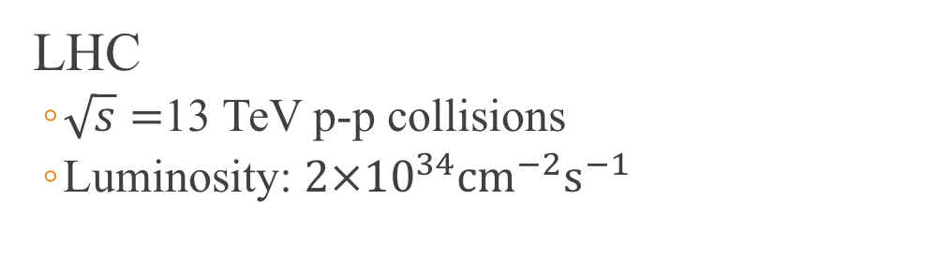
Compact Muon Solenoid (CMS)
LHC
$\sqrt{s}=$13 TeV p-p collisions
Luminosity: $2×{10}^{34}{\text{cm}}^{−2}{\text{s}}^{−1}$

Slide 14
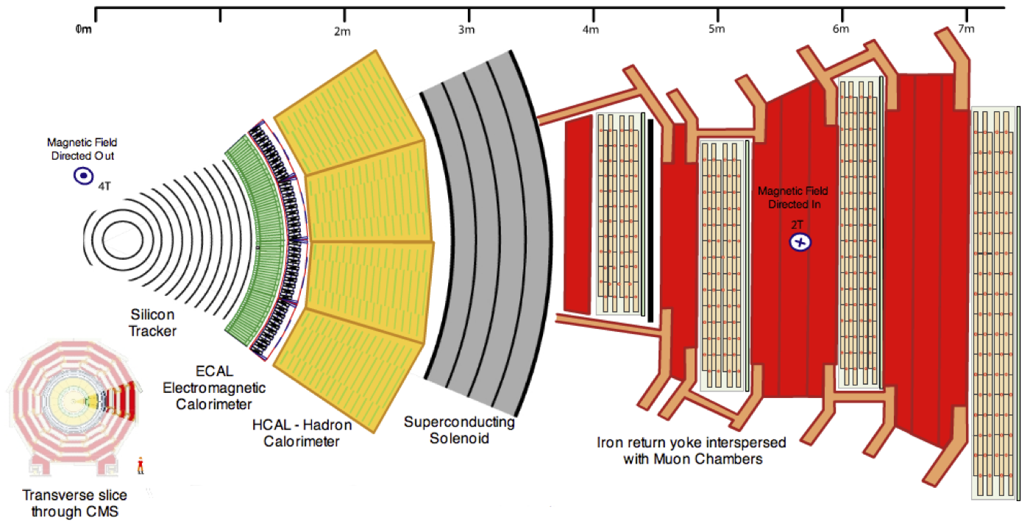
CMS Detector

Slide 15
Muon Interaction

Slide 16
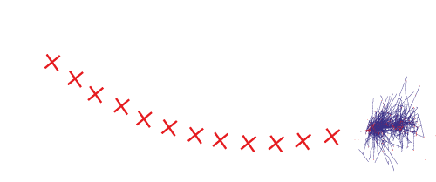
Electron Interaction

Slide 17

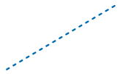
Photon Interaction

Slide 18
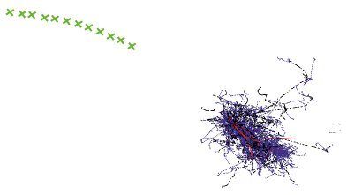
Charged Hadron Interaction

Slide 19
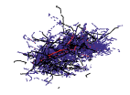

Neutral Hadron Interaction

Slide 20
Outline
Standard Model
What is it?
Dark Matter
Why SUSY?
Compact Muon Solenoid
Different methods of detection
All-hadronic Top Squark Search
Kinematic Variables
Search region design
Background estimation

Slide 21
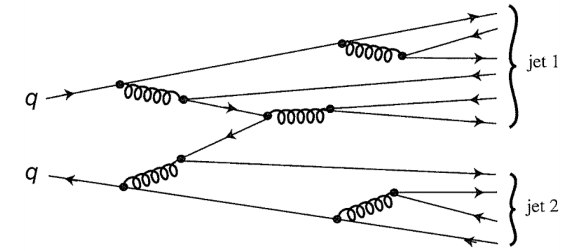
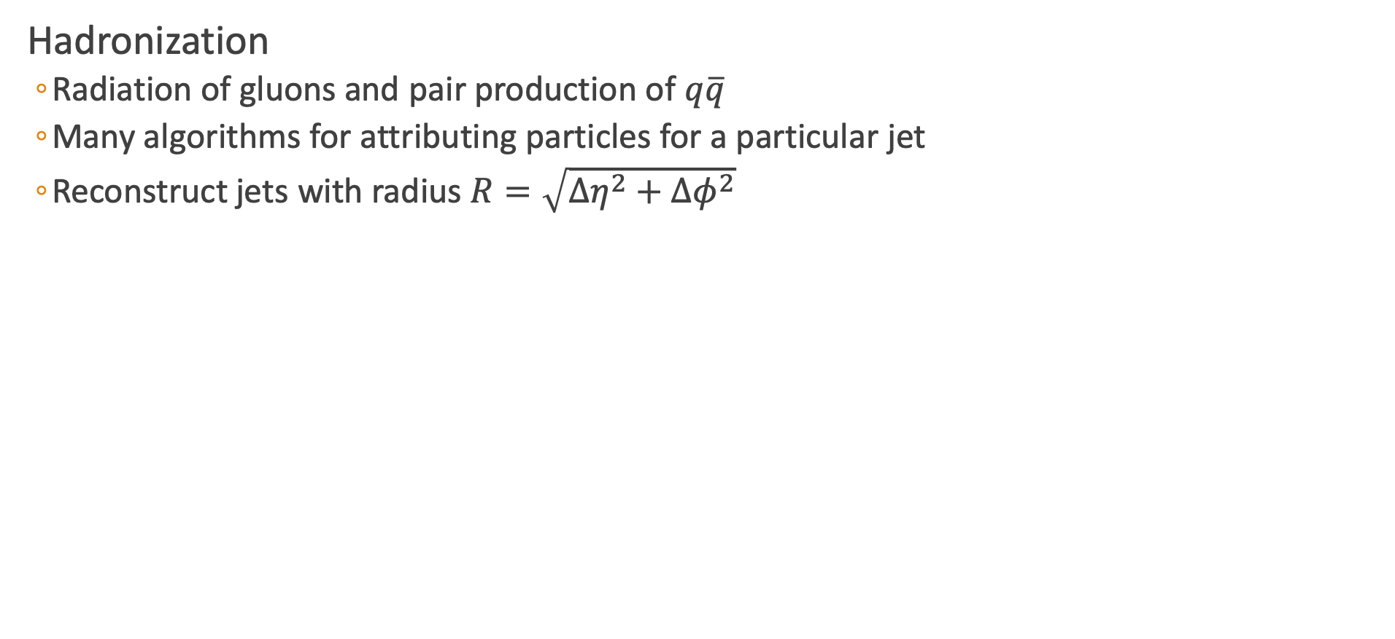
Jet Reconstruction
Hadronization
Radiation of gluons and pair production of $q\overline{q}$
Many algorithms for attributing particles for a particular jet
Reconstruct jets with radius $R=\sqrt{Δη^{2}+Δφ^{2}}$

Slide 22
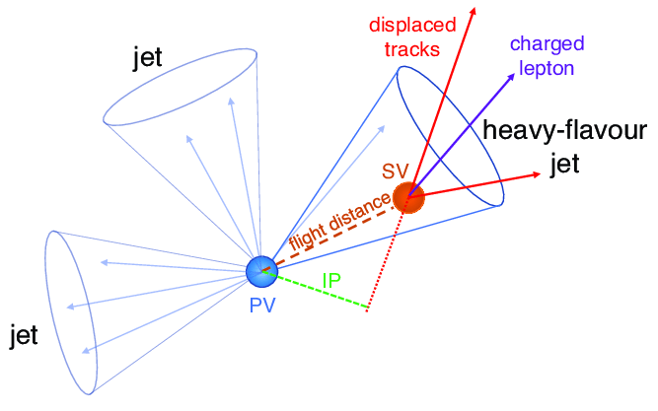
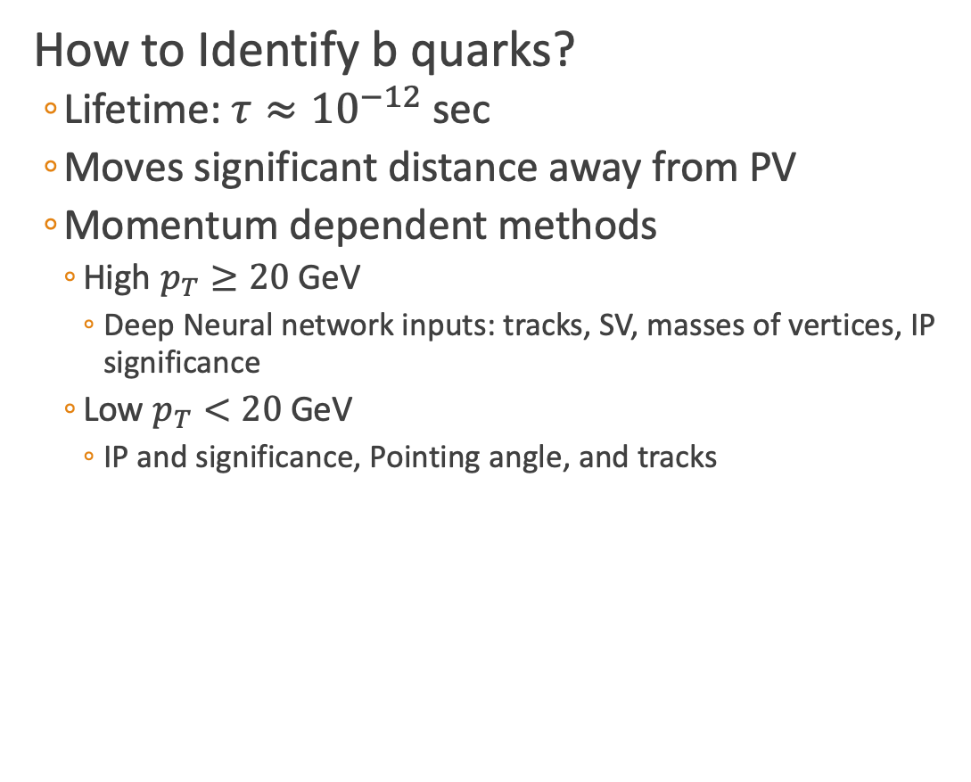
B Tagging
How to Identify b quarks?
Lifetime: $τ≈{10}^{−12}$ sec
Moves significant distance away from PV
Momentum dependent methods
High $p_{T}≥20$ GeV
Deep Neural network inputs: tracks, SV, masses of vertices, IP significance
Low $p_{T}<20$ GeV
IP and significance, Pointing angle, and tracks

Slide 23
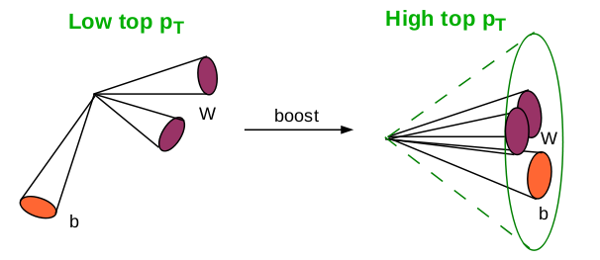
Heavy Object Tagging
Different Types of Top Reconstruction
Resolved tops
Can distinguish each individual jet of the top decay
Three jets with invariant mass of 100-250 GeV
Merged top/W
Boosted jets

Slide 24
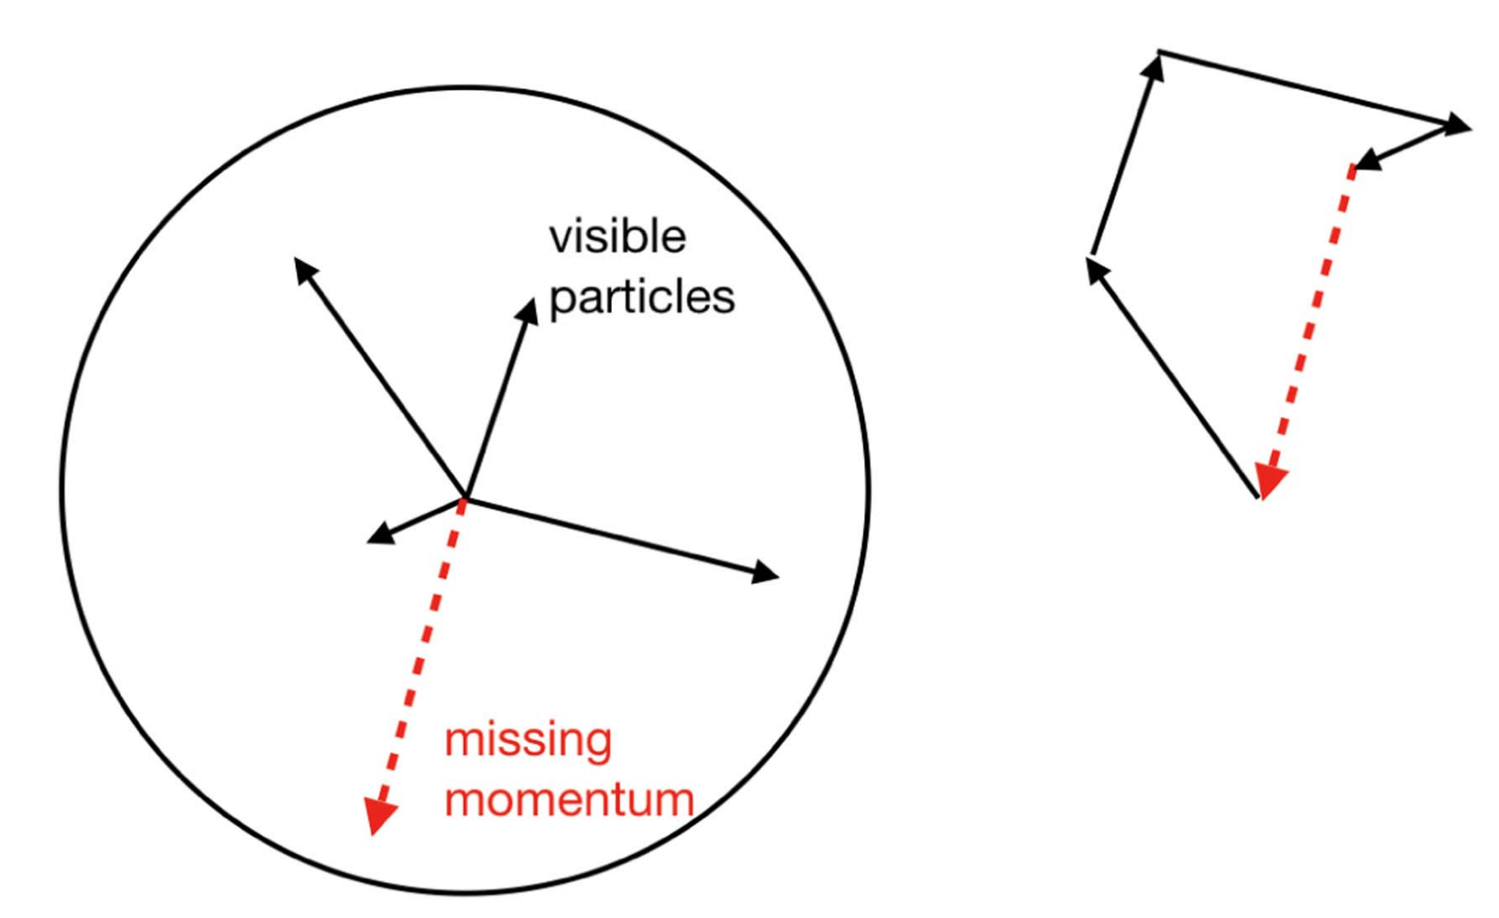
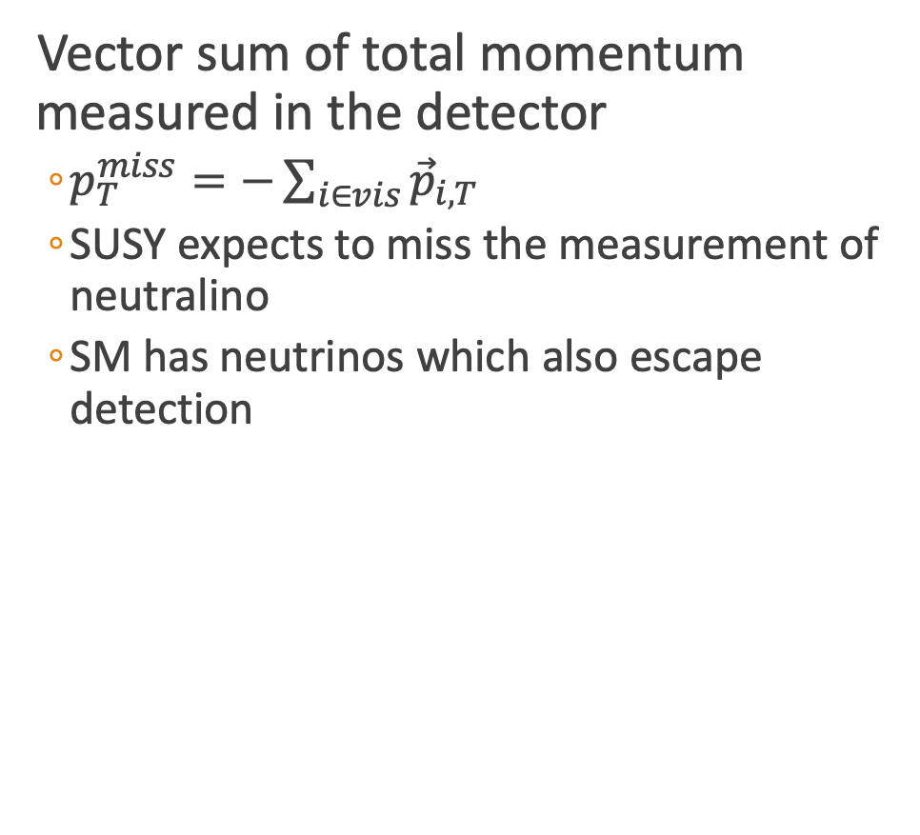
Missing Transverse Momentum
Vector sum of total momentum measured in the detector
$p_{T}^{miss}=−\sum_{i∈vis}{{\vec{p}}_{i,T}}$
SUSY expects to miss the measurement of neutralino
SM has neutrinos which also escape detection
[1]

Slide 25
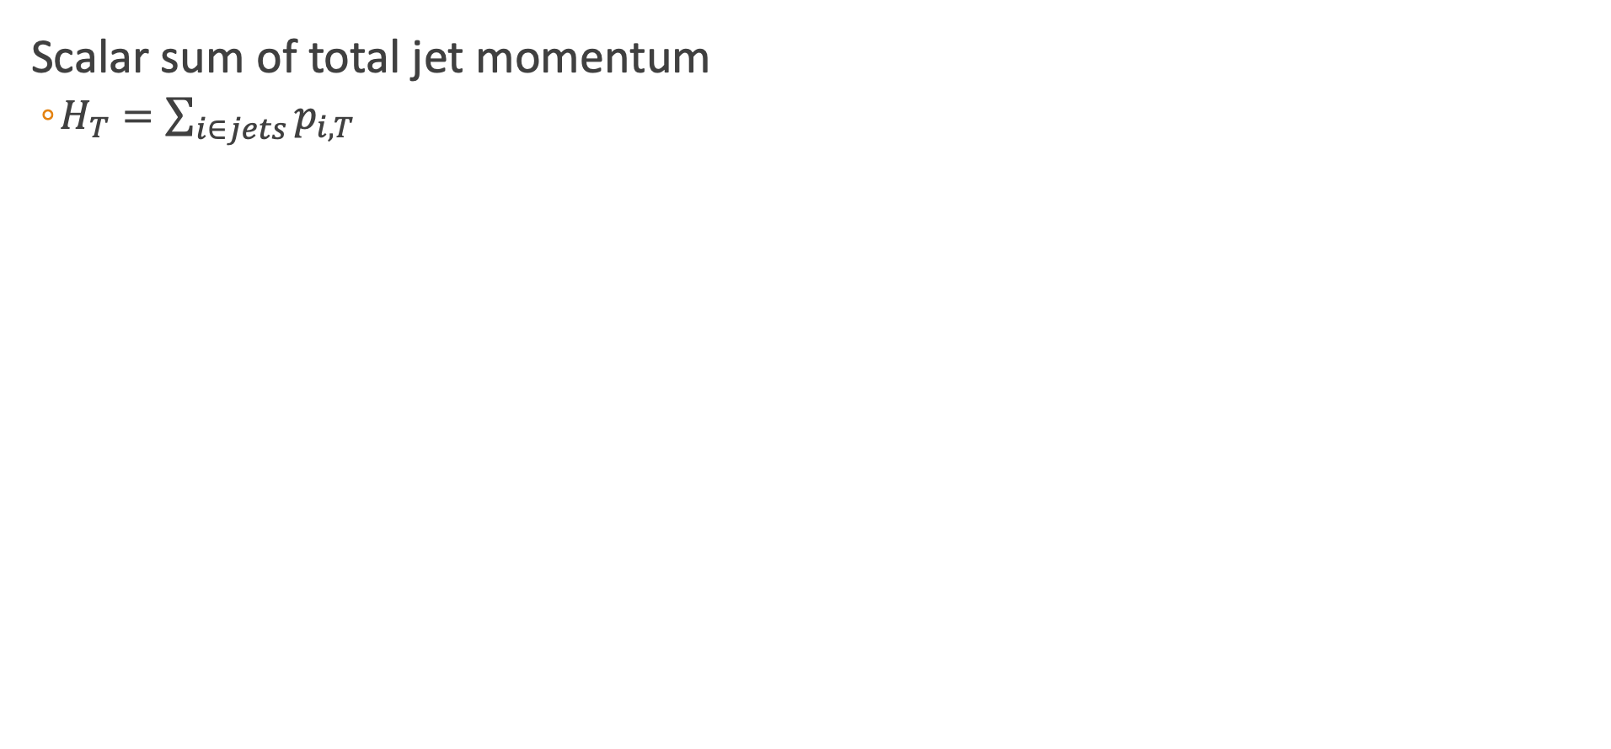
$$H_{T}$$
Scalar sum of total jet momentum
$H_{T}=\sum_{i∈jets}{p_{i,T}}$

Slide 26
Electron and Muon Identification

Slide 27
Tau Identification

Slide 28
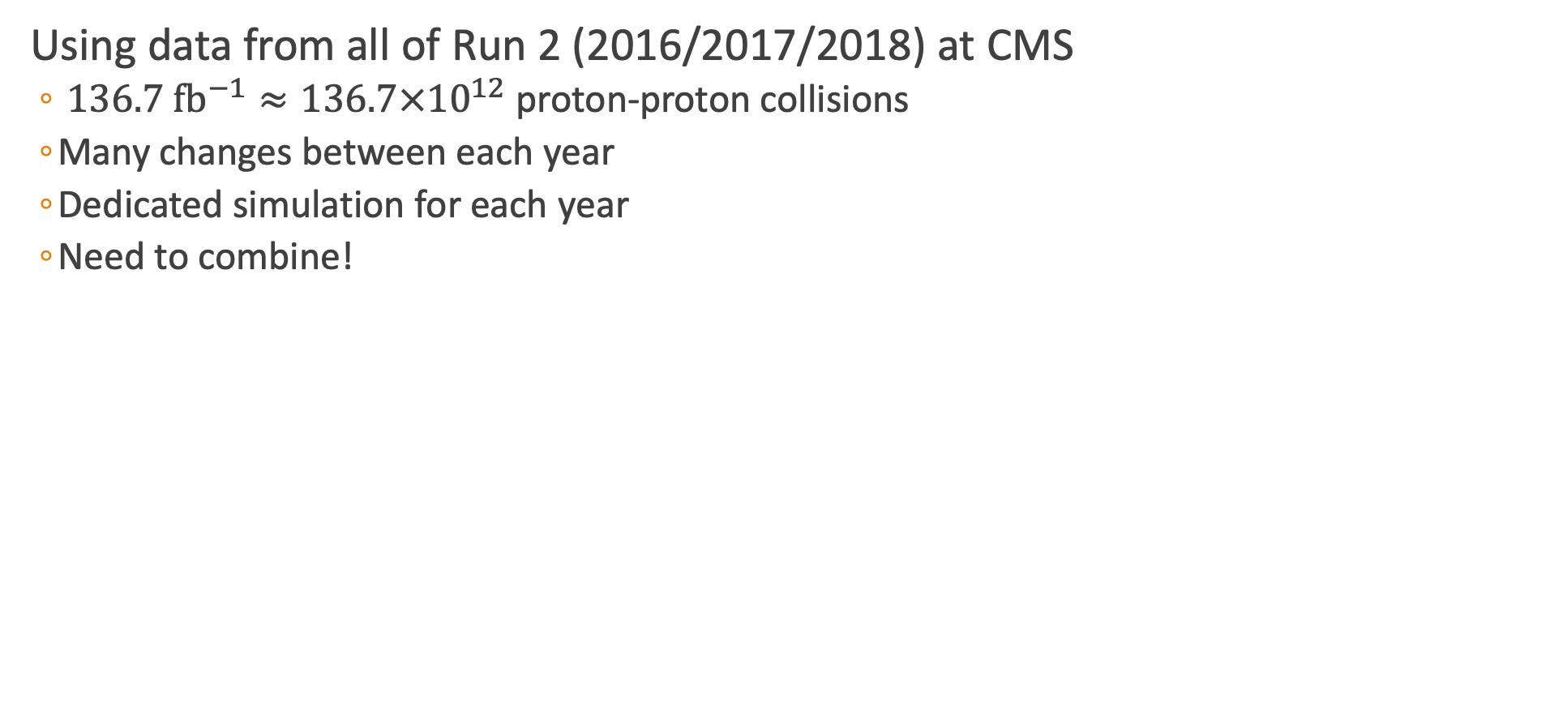
Data Methods
Using data from all of Run 2 (2016/2017/2018) at CMS
$136.7 {\text{fb}}^{−1}≈136.7×{10}^{12}$ proton-proton collisions
Many changes between each year
Dedicated simulation for each year
Need to combine!

Slide 29
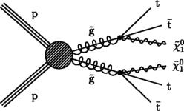
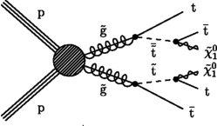
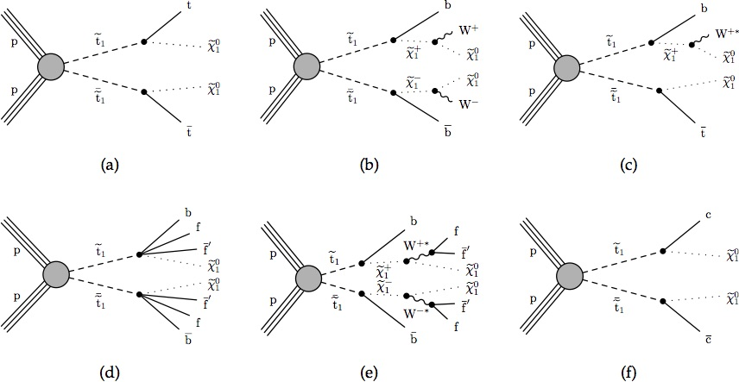
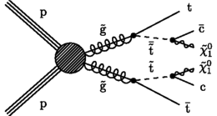
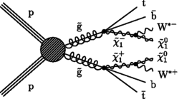
Simplified SUSY Models
Looking at inclusive models for a most general stop search
Gluino Mediated Stop Production
Direct Stop Production

Slide 30
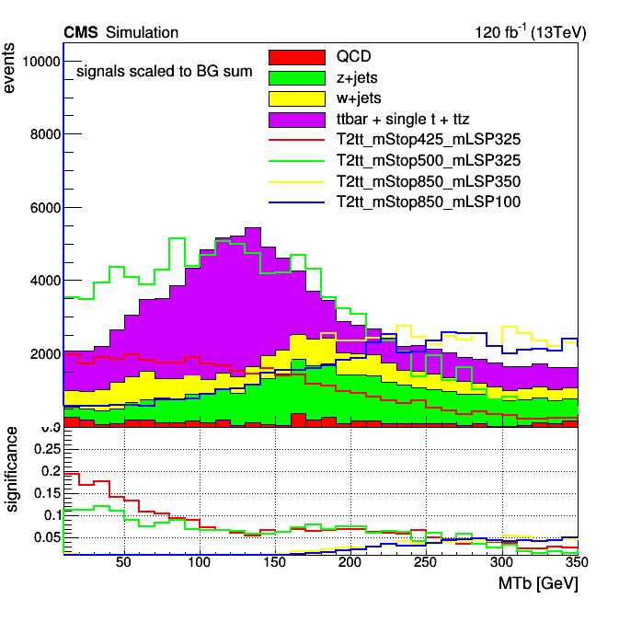



Search Strategy
Categorize low $Δm$ and high $Δm$ by $M_{T}\left(b_{1,2},p_{T}^{miss}\right)$
Low $Δm$
$M_{T}\left(b_{1,2},p_{T}^{miss}\right)<175$ GeV
Veto Tops and W
ISR Tagging
Soft-b tagging
$N_{j}≥2$
$Δφ\left(j_{1},p_{T}^{miss}\right)>0.5, Δφ\left(j_{23},p_{T}^{miss}\right)>0.15$
$\frac{p_{T}^{miss}}{\sqrt{H_{T}}}>10$
High $Δm$
$M_{T}\left(b_{1,2},p_{T}^{miss}\right)>175$ GeV
Top and W tagging
$N_{j}≥5,N_{b}≥1$
$Δφ\left(j_{1234},p_{T}^{miss}\right)>0.5$

Slide 31


Targeted Search Regions
Looking in low and high $Δm$ regions
Top Squark: $Δm=m_{\tilde{t}}−m_{\tilde{χ_{1}^{0}}}$
Gluino: $Δm=m_{\tilde{g}}−m_{\tilde{χ_{1}^{0}}}$
Search Regions
Compressed (low $Δm$)
Uncompressed (high $Δm$)
183 Search regions → 53 low + 130 high

Slide 32


Lost Lepton Background
Standard Model Background
$t\overline{t},W+jets, tW, ttW$
Causes
Lepton fails kinematic cuts
Out of detector acceptance
How to estimate for all of Run 2?

Slide 33

Compare Inclusive Regions
Regions with only low or high $Δm$

Slide 34

Transfer Factor Methods
LL Contribution
Control region (electron/muon): $N_{lep}=1, M_{T}\left(l,p_{T}^{miss}\right)<100$ GeV
Search region: $N_{lep}=0$
$N_{pred}^{LL}=\frac{N_{MC}(0l)}{N_{MC}(1l)}∙N_{data}(1l)$
$TF_{LL}=\begin{matrix}TF_{LL}^{CR−SR}×TF_{LL}^{SR−extrap} \\ \frac{N_{MC}(0l)(N_{j},N_{b},p_{T}^{miss})}{N_{MC}(1l)(N_{j},N_{b},p_{T}^{miss})}×\frac{N_{MC}(1l)(N_{j},N_{b},p_{T}^{miss},N_{t},N_{res},N_{W})}{N_{MC}(0l)(N_{j},N_{b},p_{T}^{miss})}\end{matrix}$
Transfer Factor

Slide 35
Transfer Factor Methods
LL Contribution
Control region (electron/muon): $N_{lep}=1, M_{T}\left(l,p_{T}^{miss}\right)<100$ GeV
Search region: $N_{lep}=0$
$N_{pred}^{LL}=\frac{N_{MC}(0l)}{N_{MC}(1l)}∙N_{data}(1l)$
$TF_{LL}=\begin{matrix}TF_{LL}^{CR−SR}×TF_{LL}^{SR−extrap} \\ \frac{N_{MC}(0l)(N_{j},N_{b},p_{T}^{miss})}{N_{MC}(1l)(N_{j},N_{b},p_{T}^{miss})}×\frac{N_{MC}(1l)(N_{j},N_{b},p_{T}^{miss},N_{t},N_{res},N_{W})}{N_{MC}(0l)(N_{j},N_{b},p_{T}^{miss})}\end{matrix}$
Transfer Factor

Slide 36


Example LL Prediction

Slide 37

Z to Invisible
Events with jets and a Z decaying to two neutrinos
Large $H_{T}$ and $p_{T}^{miss}$, similar to signal

Slide 38

QCD Background
Missing Energy from the mismeasurement of jets
QCD Estimation used Transfer Factor method where:
Control Region defined regions with $Δφ(j_{123},Ɇ$) < 0.1
Search Region
Low $Δm:\left|Δφ\left(j_{1},Ɇ\right)\right|>0.5, \left|Δφ\left(j_{23},Ɇ\right)\right|>0.15$
High $Δm:ΔΦ(j_{1234},Ɇ)>0.5$
Transfer Factor
$N_{pred}^{QCD}=\frac{N_{MC}^{QCD}\left(SR\right)}{N_{MC}^{QCD}\left(CR\right)}∙(N_{data}−N_{MC}^{non−QCD})$
Take MC events and do smearing (from 2 leading jets)
Statistical Uncertainty for the TF
Increasing the effective luminosity with a method called “local smearing”
Transfer Factor

Slide 39

QCD Smearing Method
Methods based on the jet response (JR) function
Parameterize jet reconstruction
Binned in $p_{T}$ and jet flavor
Local Smearing
Using centrally produced MC, generate an ensemble of smeared event with new reco jet $p_{T}$
Consider the two leading jets
Start at JR for standard MC ( )
Sample in small window ( )
Recalculate variables
Small window $→$ does not bias jet quantities
CMS Work in progress
Probability

Slide 40
Backup

Slide 41



${\tilde{t}}_{1}$: Dynamic Reason to be at bottom of sParticles
Quark left and right superpartners can strongly mix to form mass eigenstates
$M_{\tilde{t_{1}}}^{2}=\left(\begin{matrix}{\tilde{M}}_{Q_{3}}^{2}+M_{t}^{2}+M_{Z}^{2}\left(\frac{1}{2}−\frac{2}{3}\sin^{2}{θ_{W}}\right)cos2β & v\left(a_{t}^{∗}sinβ−μy_{t}cosβ\right) \\ v\left(a_{T}^{∗}sinβ−μy_{t}cosβ\right) & {\tilde{M}}_{{\overline{u}}_{3}}^{2}+M_{t}^{2}+\frac{2}{3}M_{Z}^{2}\sin^{2}{θ_{W}cos2β}\end{matrix}\right)$
Strong mixing in the stop sector
Could lead to ${\tilde{t}}_{1}$being the lightest squark
Notes:
Y_t is the Yukawa coupling(interaction between a scalar field and Dirac field),

Slide 42


The Tracker Detector
Outer Tracker
Active area: 200 ${\text{m}}^{2}$, 15148 modules
10 layers in barrel region
9 + 3 in inner disks and endcaps
Analog readout
Phase 1 Pixel Tracker
4 barrel layers
3 endcap disks on each side
124 million pixel channels
Digital Readout

Slide 43




Phase 1 Pixels
Replaced in winter 2016/2017
Approximately 1 m long
Designed for peak luminosity of $2.5×{10}^{34}{ \text{cm}}^{−2}{\text{s}}^{−1}$ with 50 ns bunch crossings
Analog $→$ digital
New data acquisition (DAQ)
DCDC powering
${\text{CO}}_{2}$ cooling
Light weight
Cost effective
Layer 1 closer to beam line
43 mm to 30 mm
Layer 4 extends to 160 mm

Slide 44


Anti-kT Algorithm
Distance calculation
$d_{ij}=\text{min}(k_{Ti}^{−2},k_{Tj}^{−2})\frac{{\left(y_{i}−y_{j}\right)}^{2}+{\left(φ_{i}−φ_{j}\right)}^{2}}{R^{2}}$
$d_{iB}=k_{Ti}^{−2}$
Infrared safe
Circular jet area
Notes:
Infrared safe: reconstruction is unaffected by soft radiation of photons
Jet area: unaffected by soft radiation, low pT photons will not have a min from the above
P = 1: Inclusive kT algorithm
P = 0: Inclusive Cambridge/Aachen algorithm

Slide 45

Stop Cross Section
Cross section-probability that two particles will collide and react a certain way

Slide 46

Baseline Selection
Lepton Selection
Veto ID electron: $p_{T}>5$ GeV, $\left|η\right|<2.5$
Loose muon: $p_{T}>5$ GeV, $\left|η\right|<2.5$
IsoTrack: cut based charged PF candidate
TauPOG: $p_{T}>20$ GeV, $\left|η\right|<2.4$, medium working point
$N_{j}\left(p_{T}>20 \text{GeV}\right)≥2,\left|η\right|<2.4$
$Δφ\left(j_{1},p_{T}^{miss}\right)>0.5,Δφ\left(j_{23},p_{T}^{miss}\right)>0.15$
$p_{T}^{miss}>250$ GeV
$H_{T}>300$ GeV
HEM Veto: $η\left[−3,−1.4\right], φ\left[−1.57,−0.87\right],p_{T}>20$ GeV
Bjets: DeepCSV medium working point
W/Top: deepAK8 tight working point
Deep Resolved Top: tight working point
Scale Factors: PUWeights, BtagWeights, ISRWeights (2016), PrefireWeights (2016/2017) for all backgrounds

Slide 47
Lost Lepton Inclusive Low DM

Slide 48
Lost Lepton Inclusive High DM

